Slide 1

Geometry
Unit 5, Lesson 1 Exploring Side-Side-Side Triangle Congruence Volume 1, pg. 223

Slide 2


Benchmarks
MA.912.GR.1.2
Prove triangle congruence or similarity using Side-Side-Side, Side-Angle-Side, Angle-Side-Angle, Angle-Angle-Side, Angle-Angle, and Hypotenuse-Leg.
MA.912.GR.2.1
Given a preimage and image, describe the transformation and represent the transformation algebraically using coordinates.
MA.912.GR.5.1
Construct a copy of a segment or an angle.
volume 1, pg. 223

Slide 3
Integrated Mathematical Thinking and Reasoning Standards
MA.K12.MTR.1.1 Actively participate in effortful learning both individually and collectively.
MA.K12.MTR.4.1 Engage in discussions that reflect on the mathematical thinking of self and others.
volume 1, pg. 223

Slide 4

Learning Target
I can use constructions and transformations to determine if SSS congruence can be used to show that two triangles are congruent.
volume 1, pg. 223

Slide 5

Warm-Up
volume 1, pg. 223

Slide 6
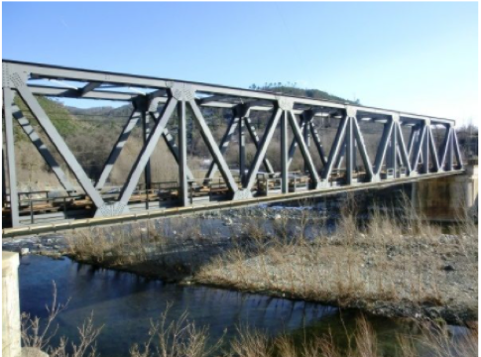
5.1.1 Warm-Up: STEM
Triangles are effective tools for architecture used in the design of buildings and other structures, as they provide strength and stability.
volume 1, pg. 223

Slide 7
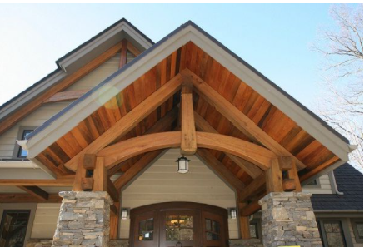
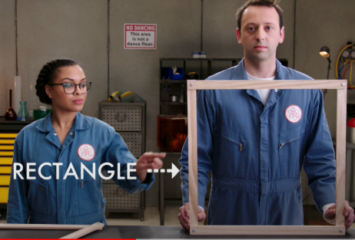
When building materials are used to form a triangle, the design has a heavy base and the pinnacle on the top is capable of handling weight because of how the energy is distributed throughout the triangle. The triangle's use in architecture dates back longer than other common architectural shapes such as the dome, arch, and cylinder. It even predates the wheel.
1. Imagine using straws or toothpicks to make a square or rectangle. What do you think will happen when the engineer puts pressure on the side of the rectangle?
volume 1, pg. 223

Slide 8
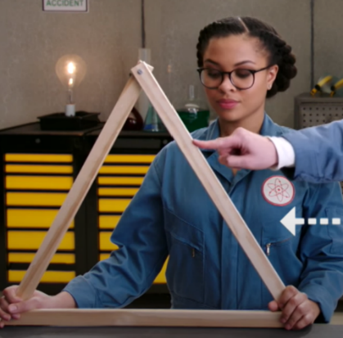
2. Now imagine you made a triangle using straws or toothpicks. What do you think will happen when the engineer puts pressure on the side of the triangle?
volume 1, pg. 224

Slide 9

Exploration
volume 1, pg. 224

Slide 10

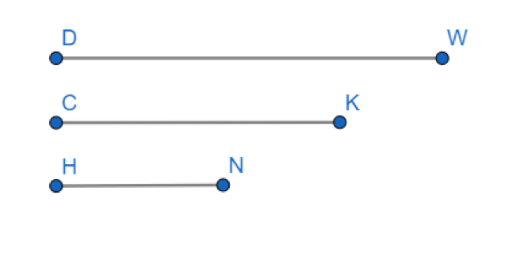
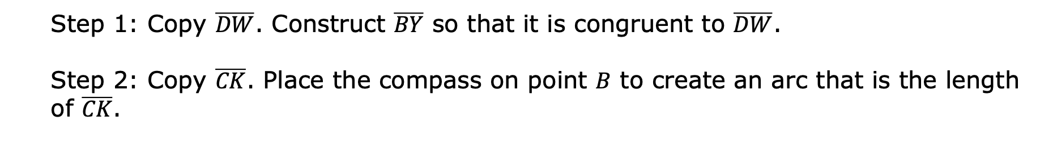
5.1.2 Exploration: Are Three Sides Enough?
$\overline{DW}$, $\overline{CK}$, and $\overline{HN}$ are given. Use the given steps to construct $∆BYT$ so that its sides are congruent to $\overline{DW}$, $\overline{CK}$, and $\overline{HN}$.
Step 1: Copy $\overline{DW}$. Construct $\overline{BY}$ so that it is congruent to $\overline{DW}$.
Step 2: Copy $\overline{CK}$. Place the compass on point $B$ to create an arc that is the length of $\overline{CK}$.
volume 1, pg. 224

Slide 11
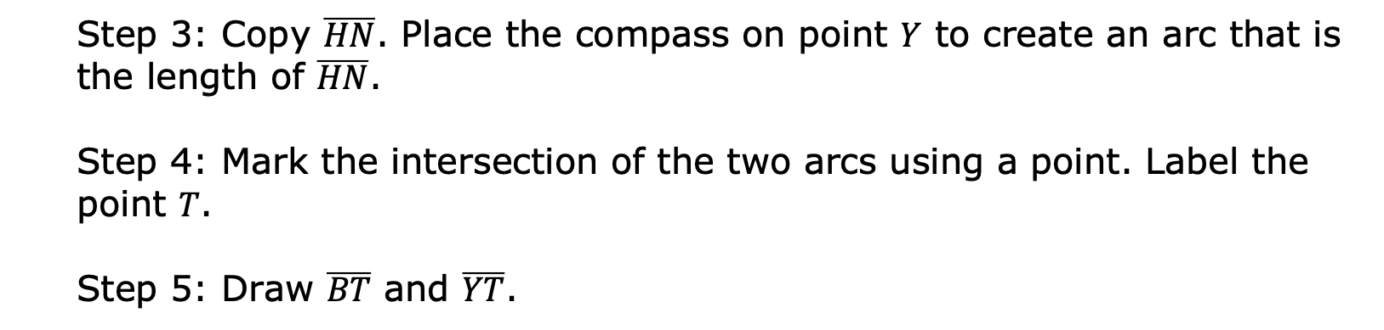
Step 3: Copy $\overline{HN}$. Place the compass on point $Y$ to create an arc that is the length of $\overline{HN}$.
Step 4: Mark the intersection of the two arcs using a point. Label the point $T$.
Step 5: Draw $\overline{BT}$ and $\overline{YT}$.
volume 1, pg. 224

Slide 12
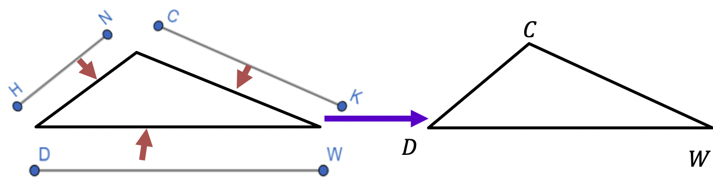
The triangle below was created using the three given line segments.
Compare the triangle you constructed with $∆CDW$. Describe any similarities or differences.
volume 1, pg. 225

Slide 13
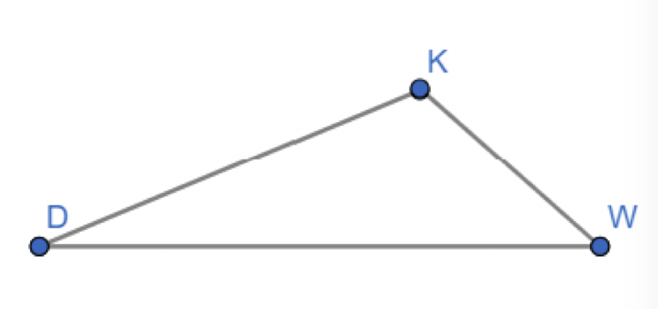
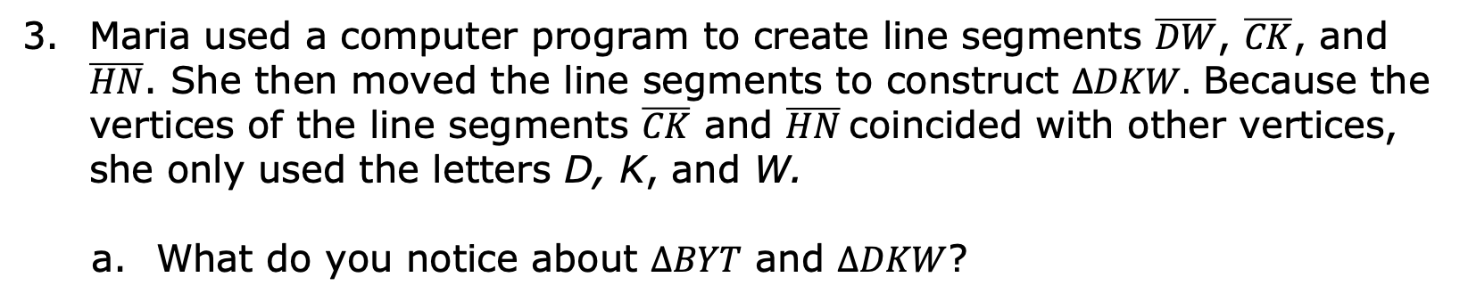
Maria used a computer program to create line segments $\overline{DW}$, $\overline{CK}$, and $\overline{HN}$. She then moved the line segments to construct $∆DKW.$ Because the vertices of the line segments $\overline{CK}$ and $\overline{HN}$coincided with other vertices, she only used the letters D, K, and W.
What do you notice about $∆BYT$ and $∆DKW$?
volume 1, pg. 225

Slide 14
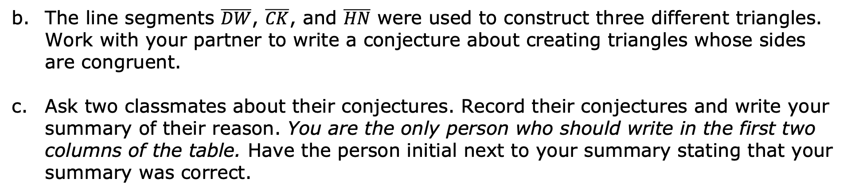
The line segments $\overline{DW}$, $\overline{CK}$, and $\overline{HN}$ were used to construct three different triangles. Work with your partner to write a conjecture about creating triangles whose sides are congruent.
Ask two classmates about their conjectures. Record their conjectures and write your summary of their reason. You are the only person who should write in the first two columns of the table. Have the person initial next to your summary stating that your summary was correct.
Conjecture for Creating Triangles Whose Sides are Congruent | My Summary of Their Reason | Initials
volume 1, pg. 225

Slide 15
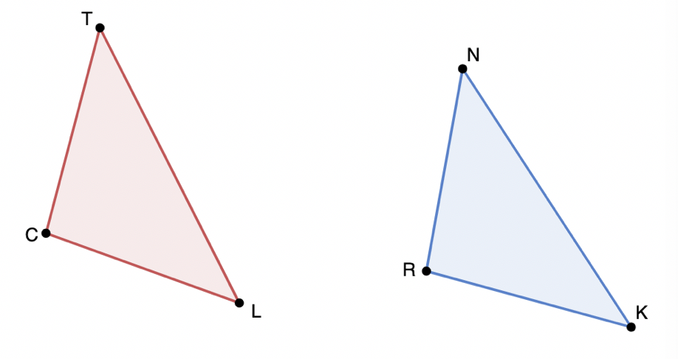

Use patty paper to determine if $∆CTL$ and $∆RNK$ were created using the same three line segments.
Discuss the following with your partner: If three sides of a triangle are congruent, does that mean all of the angles of the triangles are congruent too? Explain your decision and state the evidence used for the decision.
volume 1, pg. 226

Slide 16
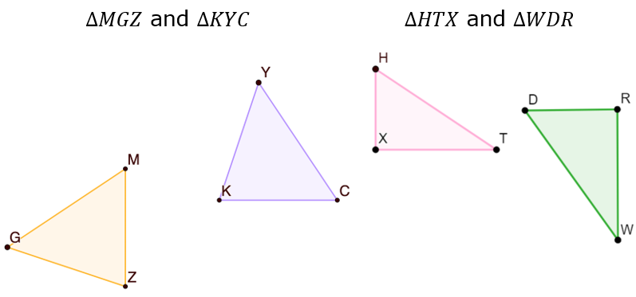
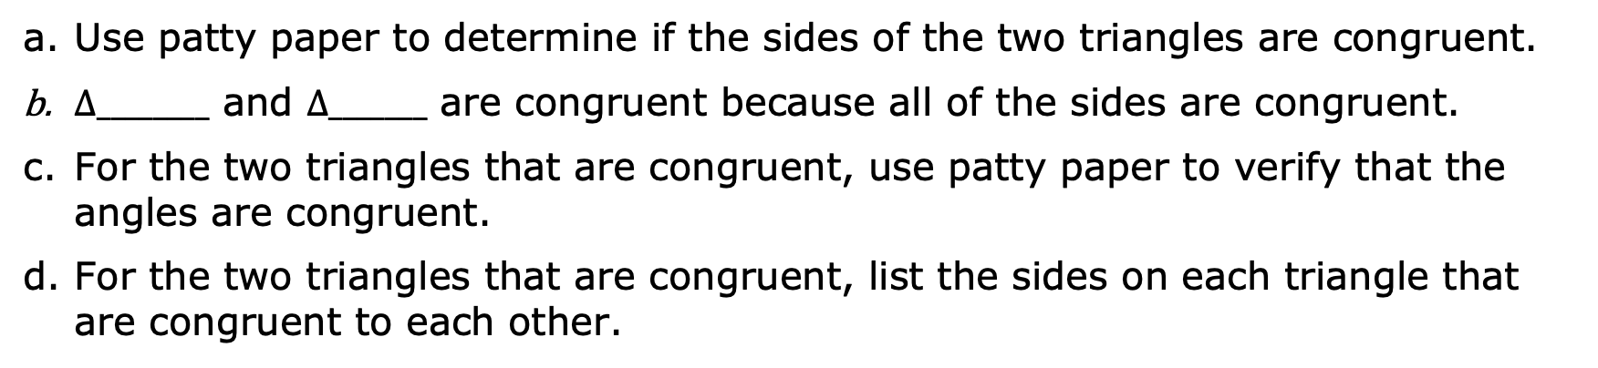
Two sets of triangles are shown.
Use patty paper to determine if the sides of the two triangles are congruent.
$∆________$ and $∆_______$ are congruent because all of the sides are congruent.
For the two triangles that are congruent, use patty paper to verify that the angles are congruent.
For the two triangles that are congruent, list the sides on each triangle that are congruent to each other.
volume 1, pg. 226

Slide 17
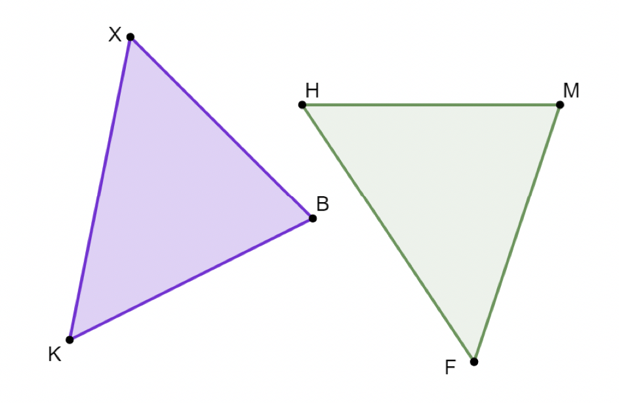
$∆KXB$ and $∆HFM$ are shown. $HM=4.2$, $XB=4.2$, $XK=5$, and $KB=4.4$.
Discuss with your partner if the given measurements are sufficient to determine whether $∆KXB$ and $∆HFM$ are congruent. Explain your decision.
volume 1, pg. 227

Slide 18
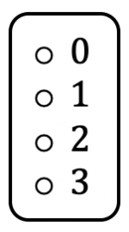
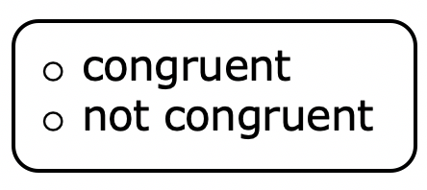
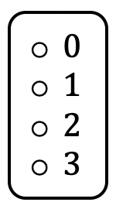
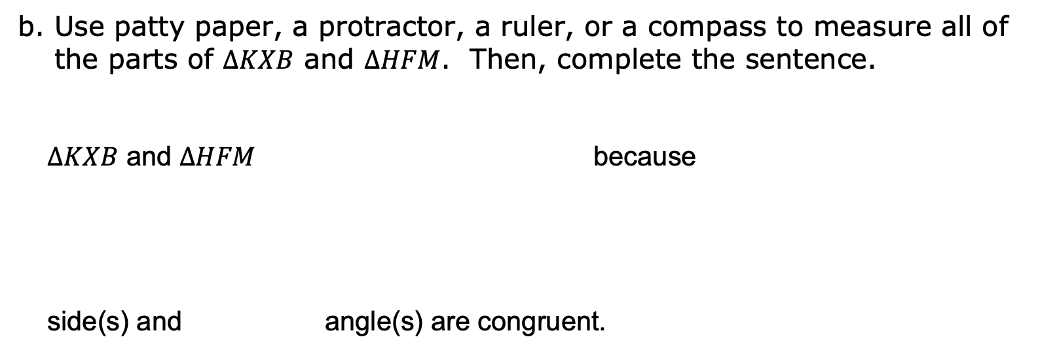
b. Use patty paper, a protractor, a ruler, or a compass to measure all of the parts of $∆KXB$ and $∆HFM$. Then, complete the sentence.
$∆KXB$ and $∆HFM$ because
side(s) and angle(s) are congruent.
volume 1, pg. 227

Slide 19
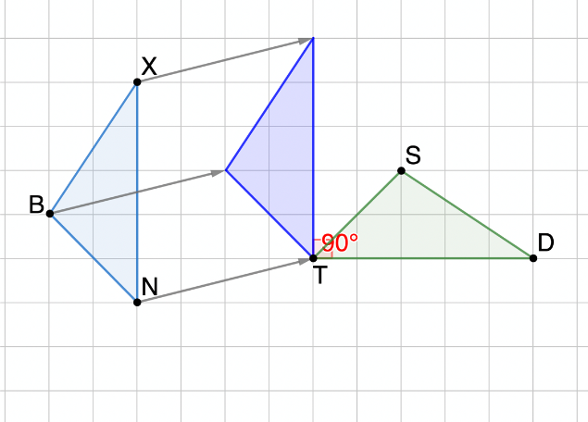
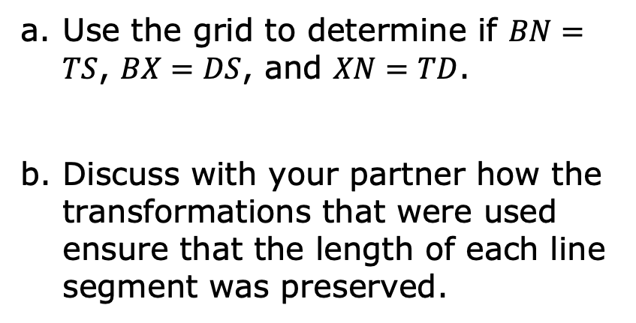
A series oaf transformations shows how $\overline{BX}$, $\overline{XN}$, and $\overline{BN}$ were translated, then rotated $90°$ about point $T$ to create $\overline{SD}$, $\overline{DT}$, and $\overline{TS}$.
Use the grid to determine if $BN=TS$, $BX=DS$, and $XN=TD$.
Discuss with your partner how the transformations that were used ensure that the length of each line segment was preserved.
volume 1, pg. 227

Slide 20
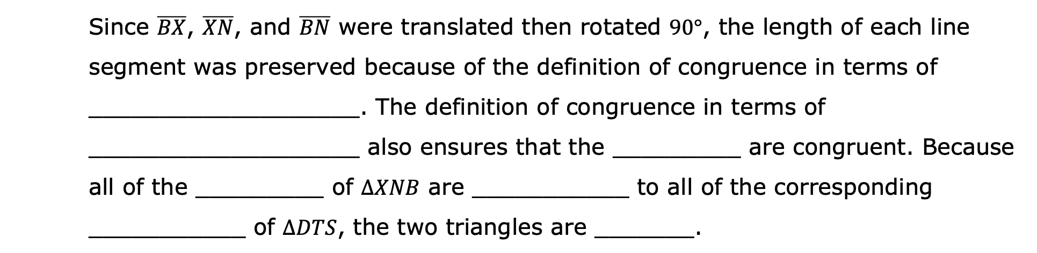
Use the word bank to complete the statements. Words may be used more than once.
Word Bank
angles | congruent | congruence | parts | rigid motions
Since $\overline{BX}$, $\overline{XN}$, and $\overline{BN}$ were translated then rotated $90°$, the length of each line segment was preserved because of the definition of congruence in terms of ___________________. The definition of congruence in terms of ___________________ also ensures that the _________ are congruent. Because all of the _________ of $∆XNB$ are ___________ to all of the corresponding ___________ of $∆DTS$, the two triangles are _______.
volume 1, pg. 228

Slide 21

Bring It Together
volume 1, pg. 228

Slide 22


5.1.3 Bring It Together: Triangle Congruence
Side-Side-Side (SSS) Congruence Postulate
Two triangles are congruent if the three sides of one are congruent to the three sides of the other, respectively.
Work with your partner to explain how the exploration has shown that the Side-Side-Side (SSS) Congruence Postulate is true.
volume 1, pg. 228

Slide 23

Wrap-Up
volume 1, pg. 229

Slide 24
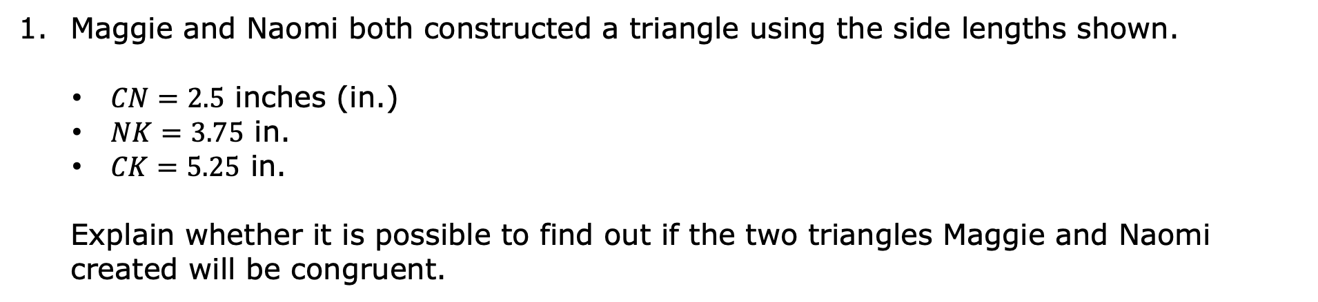
5.1.4 Wrap-Up: Cool Down
Maggie and Naomi both constructed a triangle using the side lengths shown.
$CN=2.5$ inches (in.)
$NK=3.75$ in.
$CK=5.25$ in.
Explain whether it is possible to find out if the two triangles Maggie and Naomi created will be congruent.
volume 1, pg. 229

